Slide 4



Slide 5


Slide 6
Kurzarbeit

Slide 7





Slide 9




Slide 10

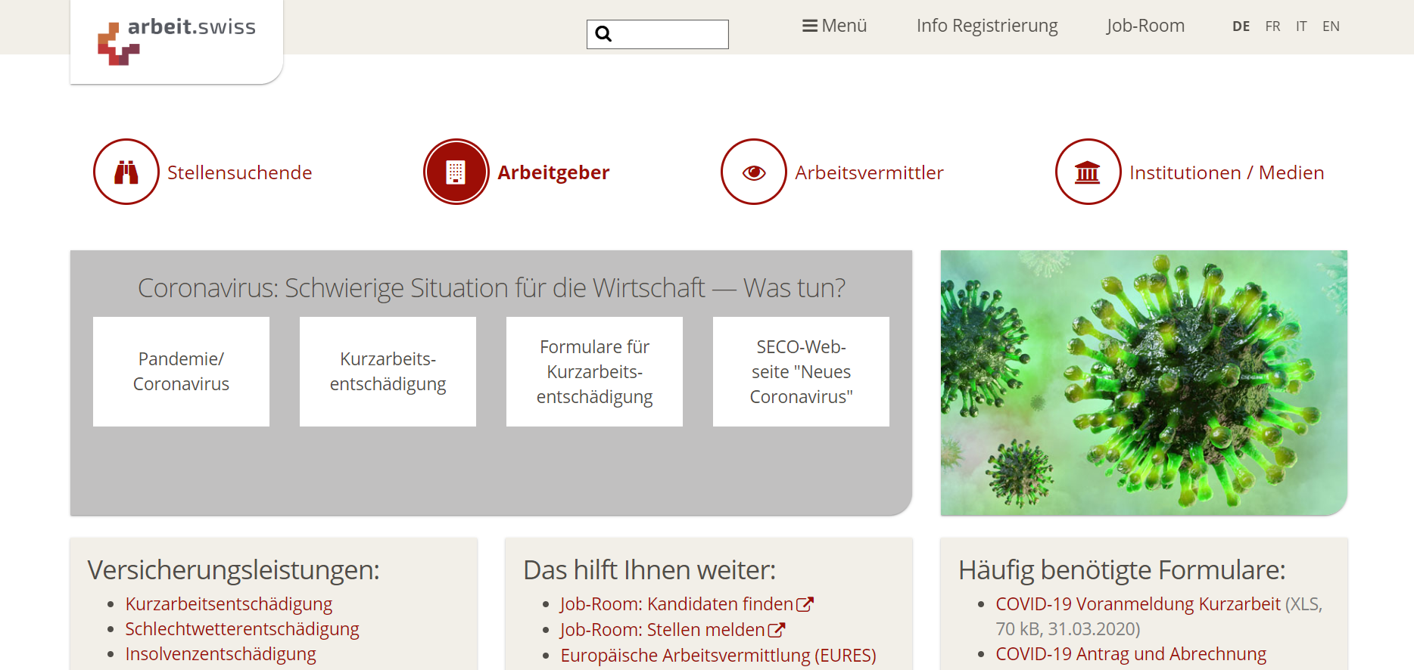

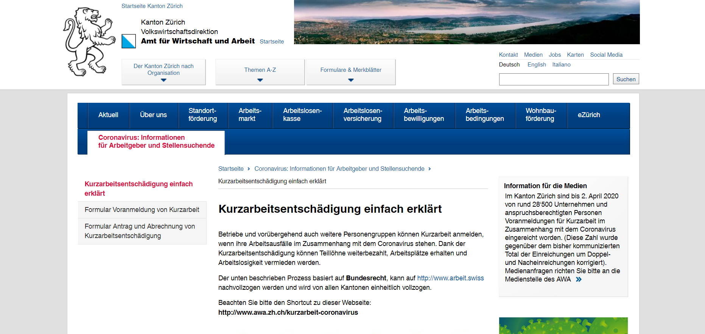

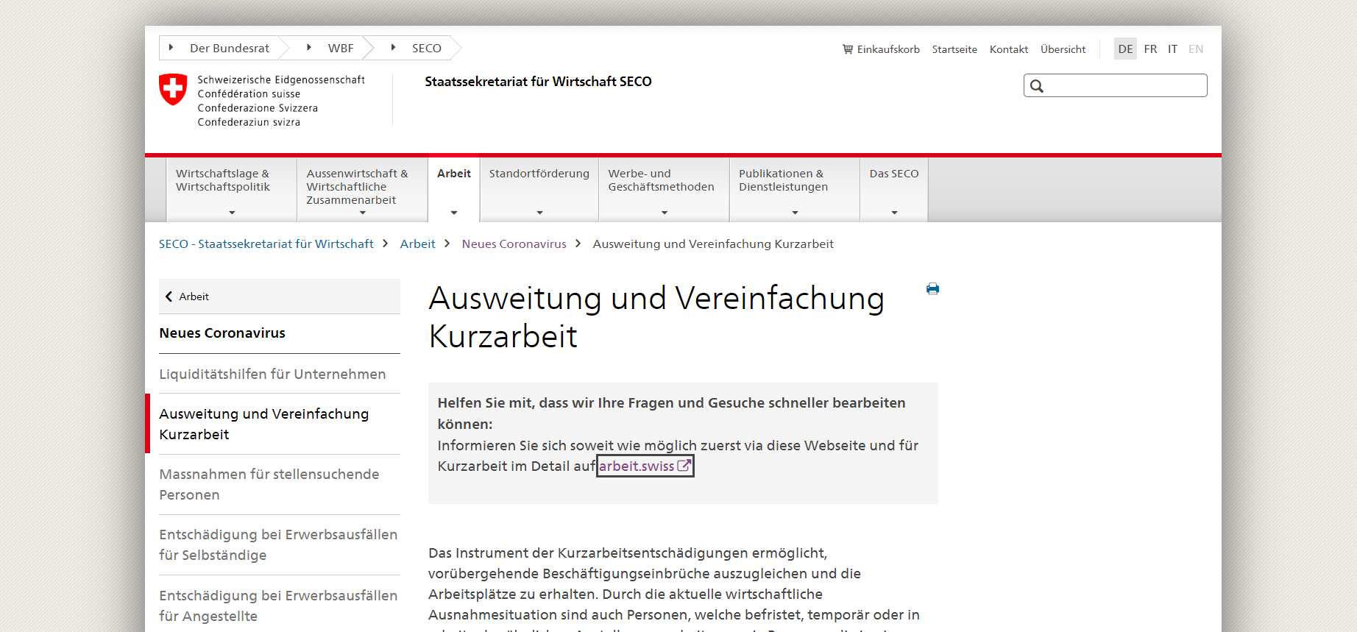
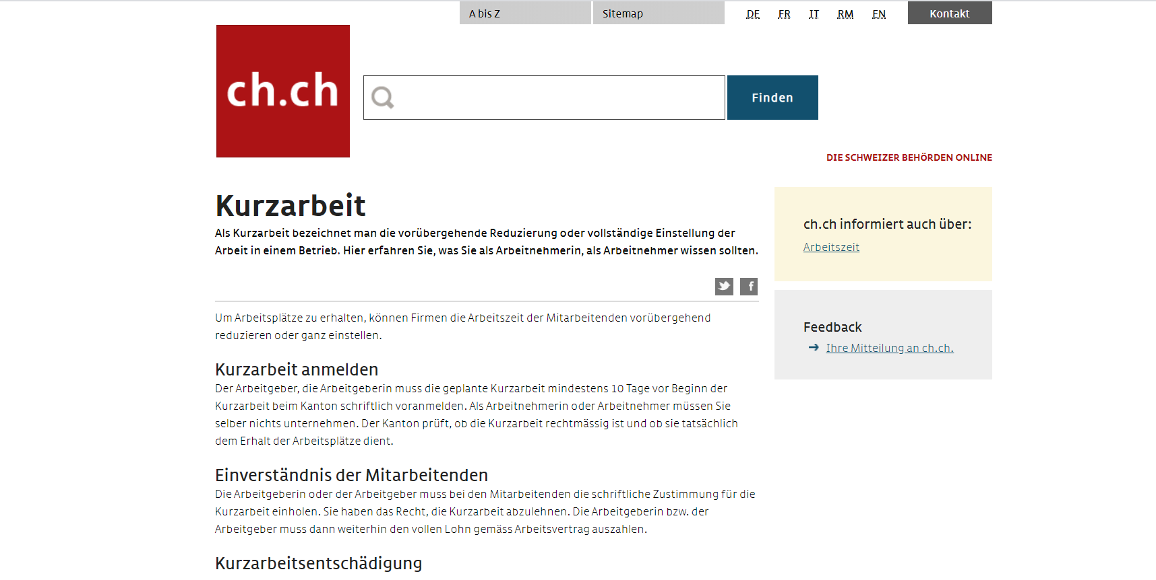
kurzarbeit schweiz

Slide 11
Numbers on the Crisis
Bad number
Fraction of empl
Daily applications
1 mio
25%
xyz
kurzarbeit schweiz
Some information
More information
Some information
More information
Some information
More information

Slide 12
kurzarbeit schweiz

Slide 13

KURABOT
kurzarbeit schweiz
www.chatbot.com

Slide 14









Behind the Scenes
KURABOT
Chatbot
Web App
Integration
Effortlessly scalable cloud solution
Customizable QnA
Corona newsticker
Live corona dashboard
Seamless integration into websites, Skype, Facebook and more

Slide 15

Implementation Roadmap
KURABOT
Collect requirements on QnAs from public authorities
Translate information and national rollout in Switzerland
Start
End
01
02
03
04
Complete web app and integrate into national website
Add further Corona-related features to web app and chatbot

Slide 16
Value Proposition
KURABOT
For authorities
For employers
For employees
Increased consultancy quality
Less congestion
Fast access to information
Less insolvencies
Faster payment settlement
Less layoffs

Slide 17
The Corona Fighters
KURABOT

Slide 18

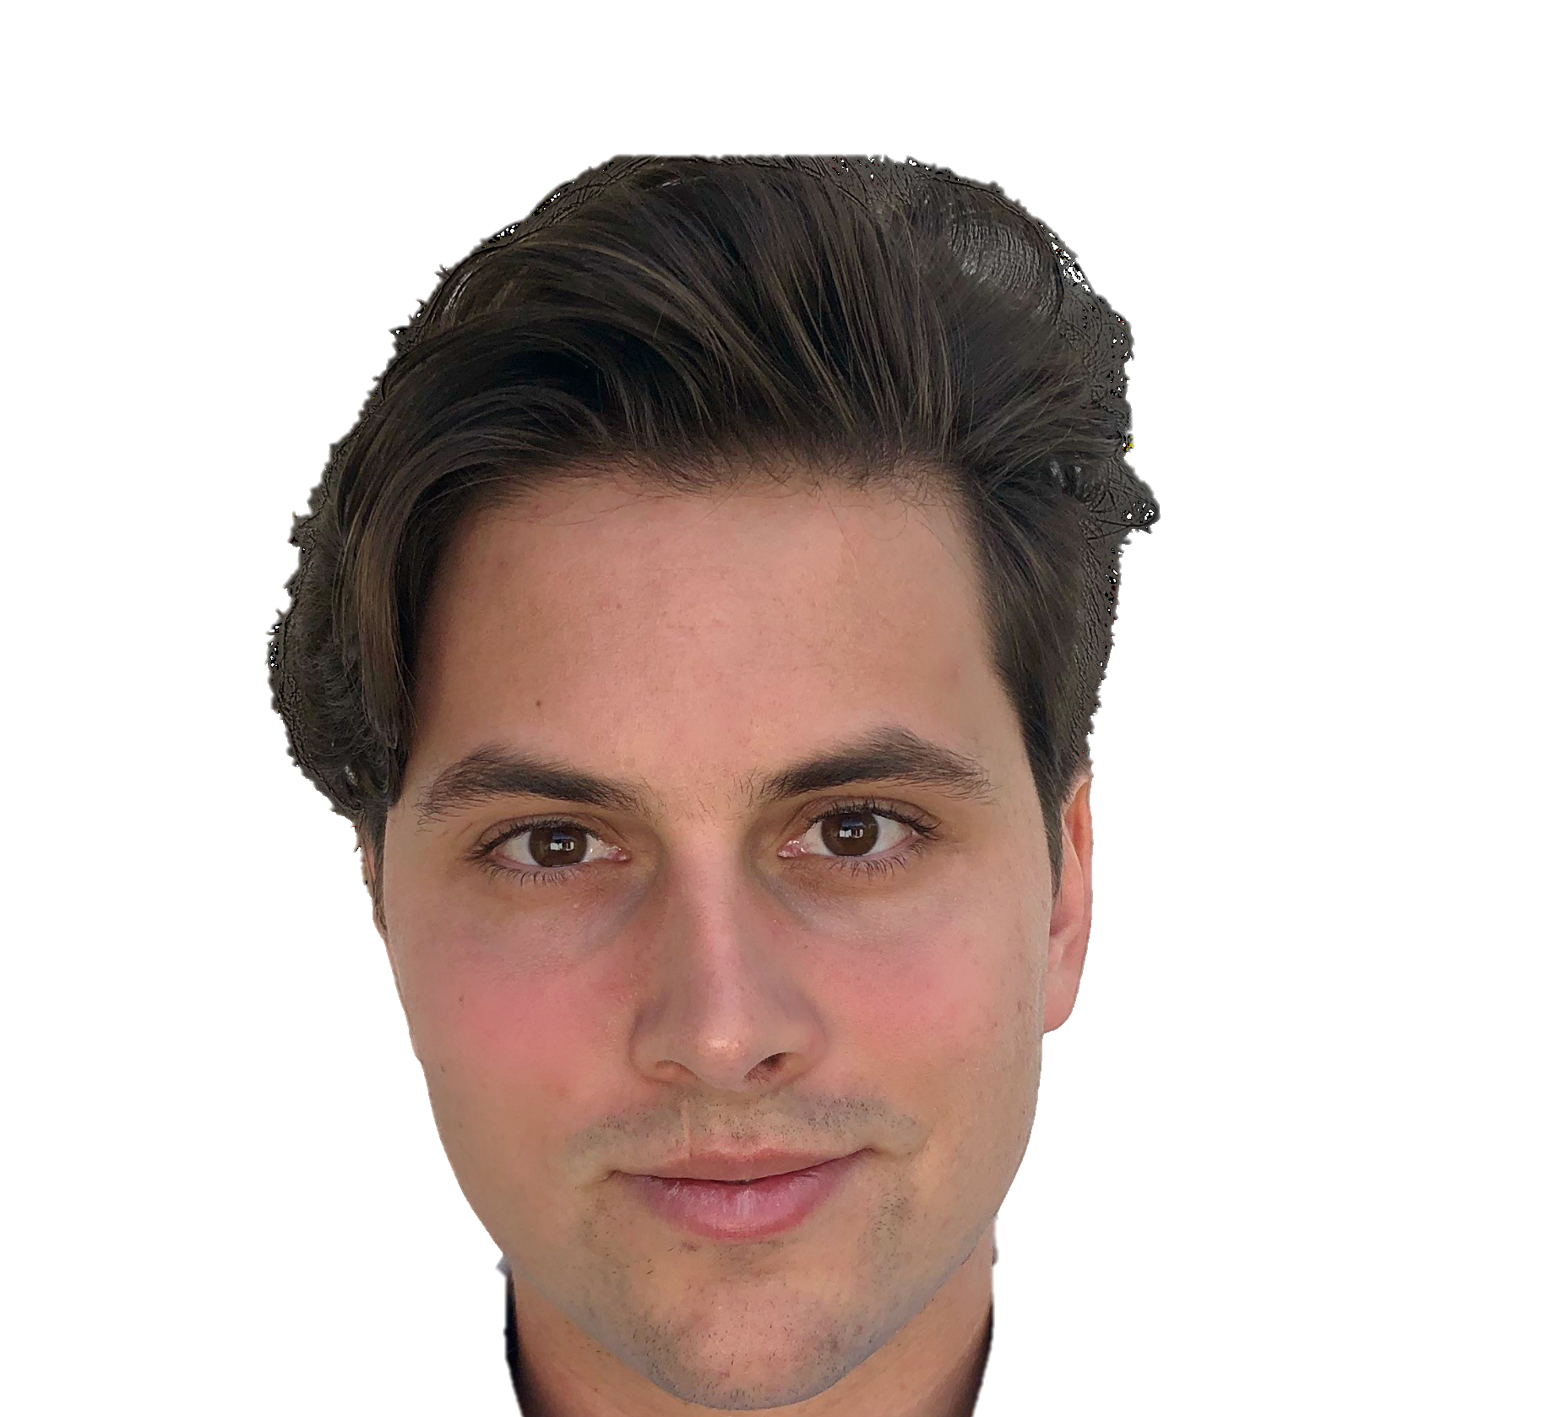
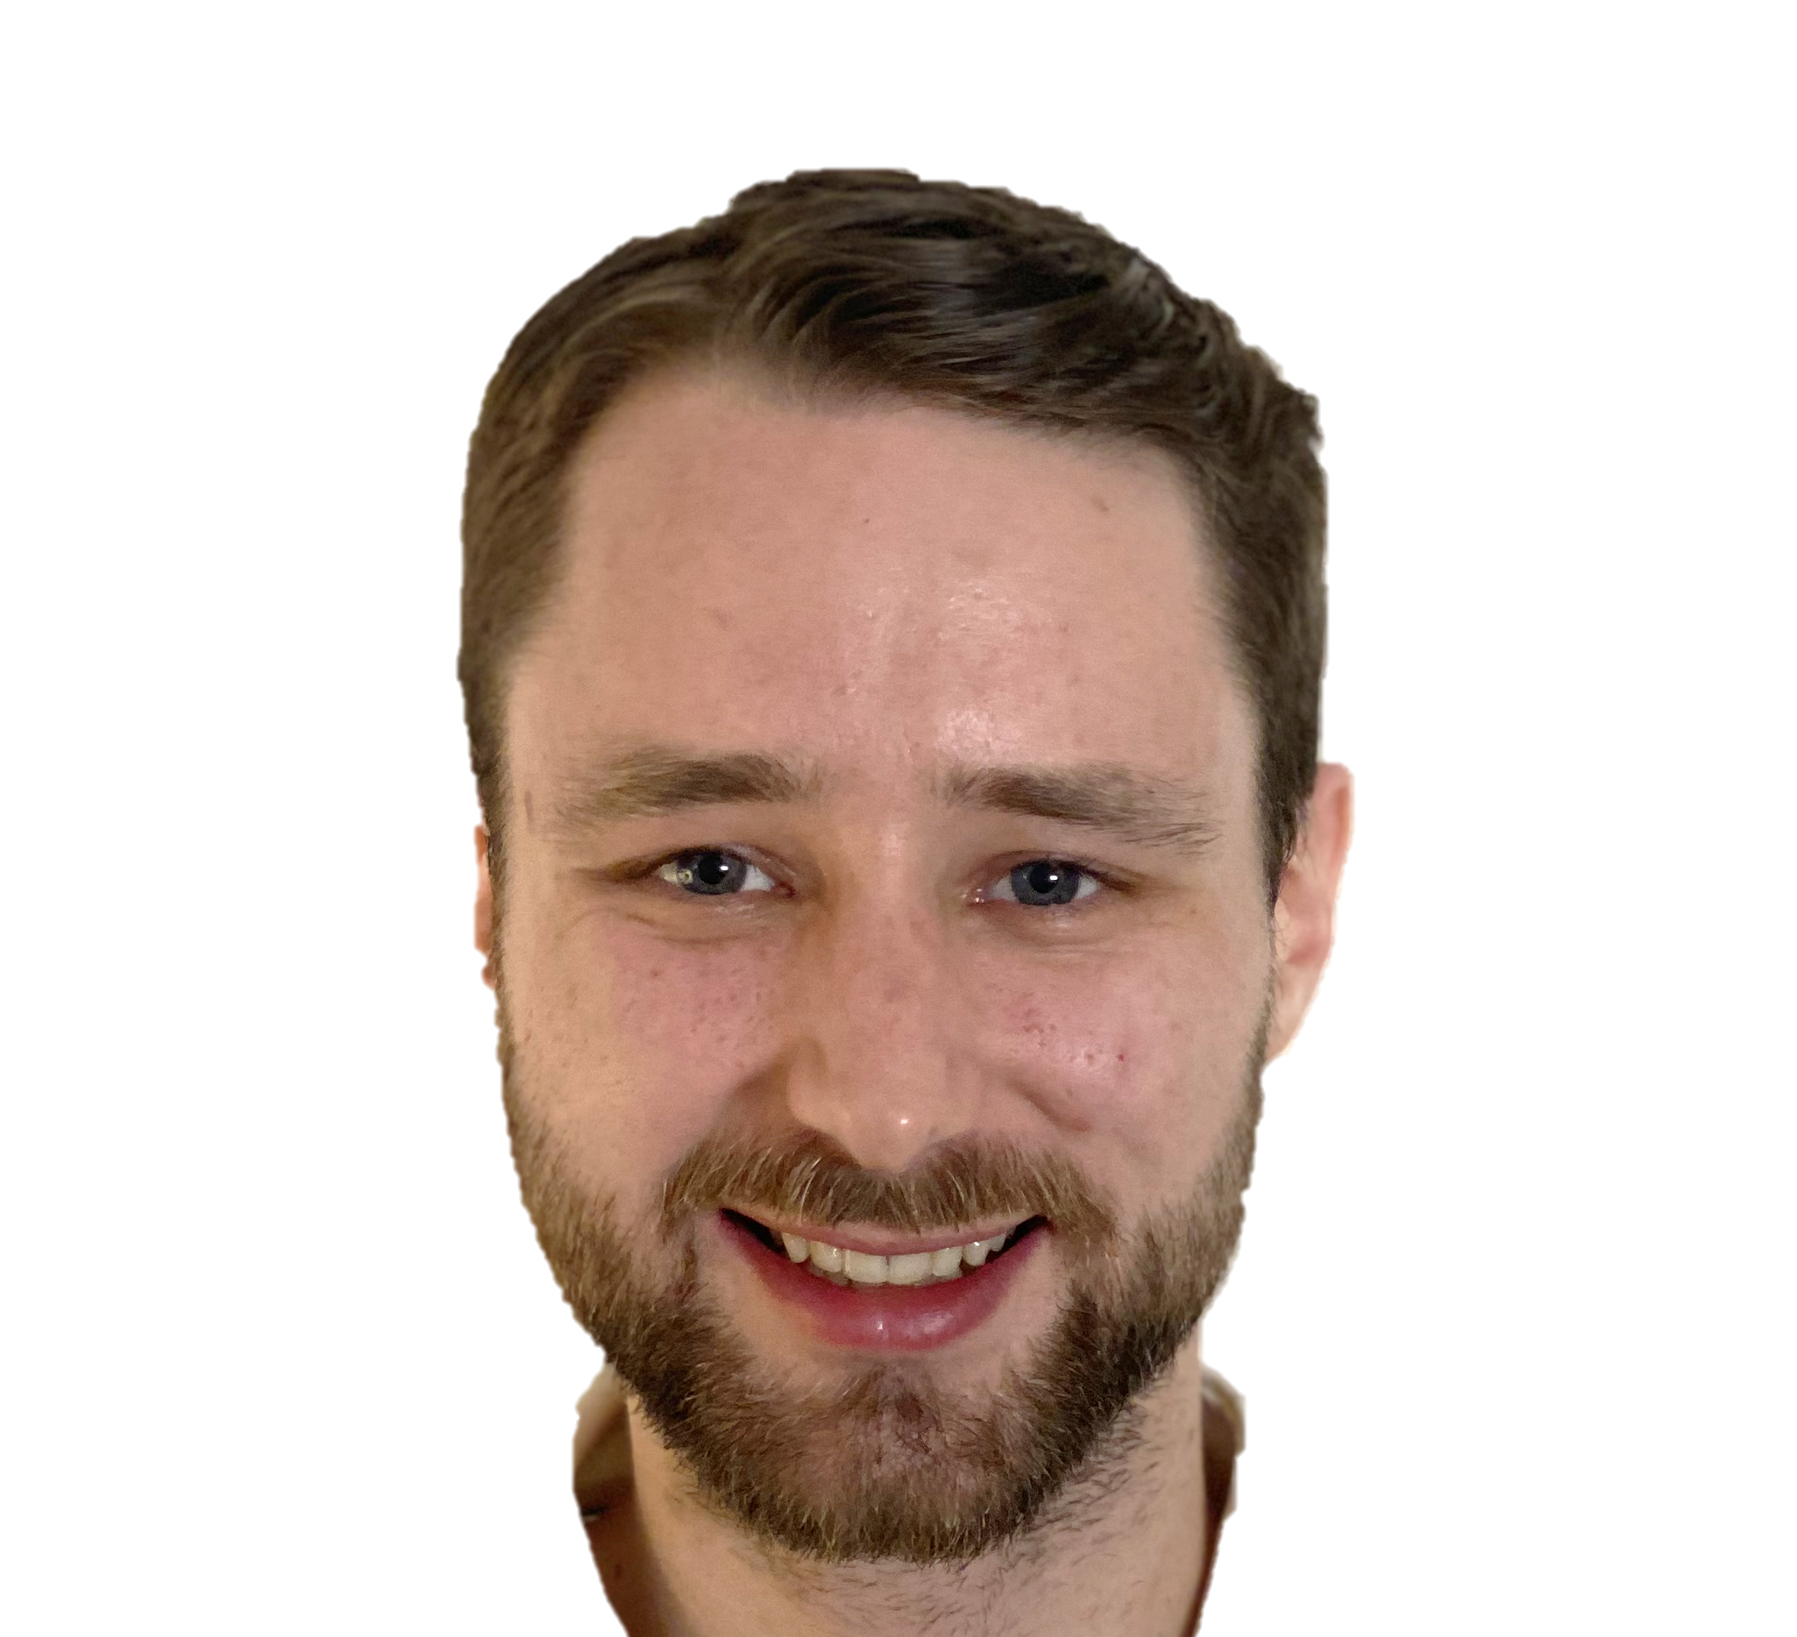


The Corona Fighters
KURABOT
Nurses
Cashiers
Doctors
Officials
and much more!
David
Stammbach
Jürg
Käser
Minh-Kha
Nguyen
Torben
Mannhart
2m
Web App
Chatbot
Business
Chatbot

